Slide 1
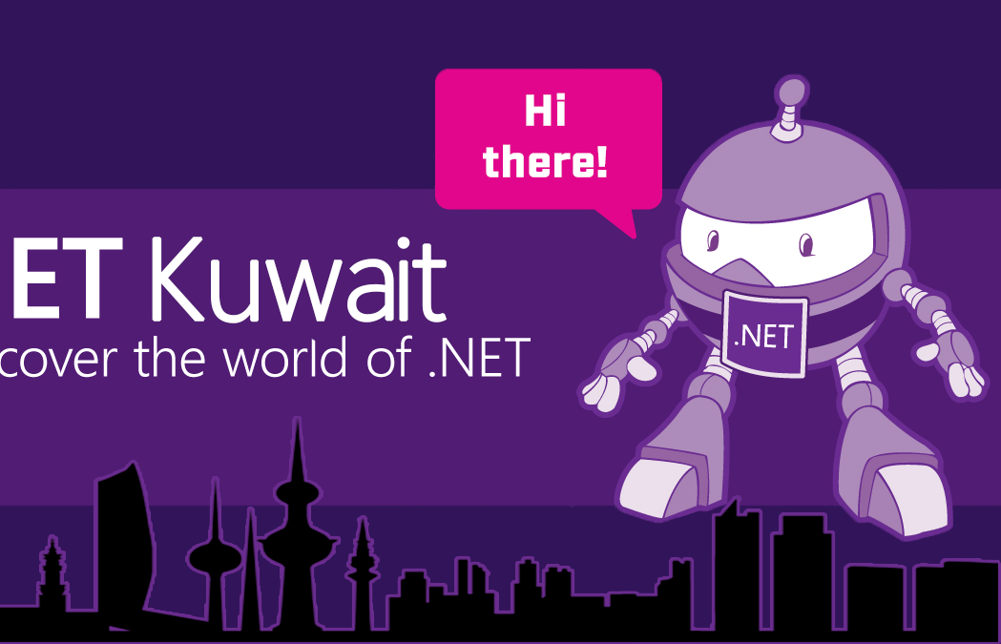
Introducing .NET Kuwait
Tariq Abubaker
Amir Ismail

Slide 2
Welcome
to
.NET KUWAIT
2

Slide 3
Who are we?
3

Slide 4
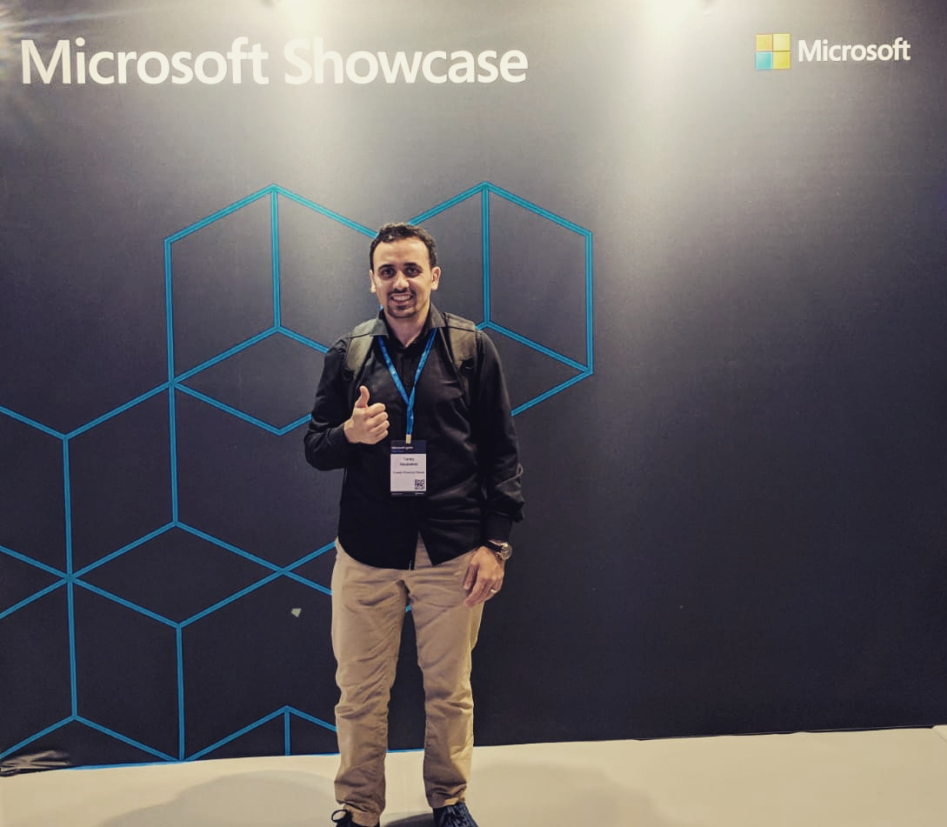


Tariq Abubaker
Overview
IT Enterprise Architect for Kuwait Finance House.
+10 years of experience in the IT and banking industry. I participated multiple projects range from SOA, EA, Core banking, Payment Solutions, Credit Cards, AML and Fraud, CRM, Retail, Finance, and IT service management solutions.
Certifications
TOGAF® 9 Certified.
DevOps Certified.
MCTS: .NET Framework 4, Web Applications.
MCP
Contact Details
https://www.linkedin.com/in/tariq-abubaker/
@taq_abubaker

Slide 5
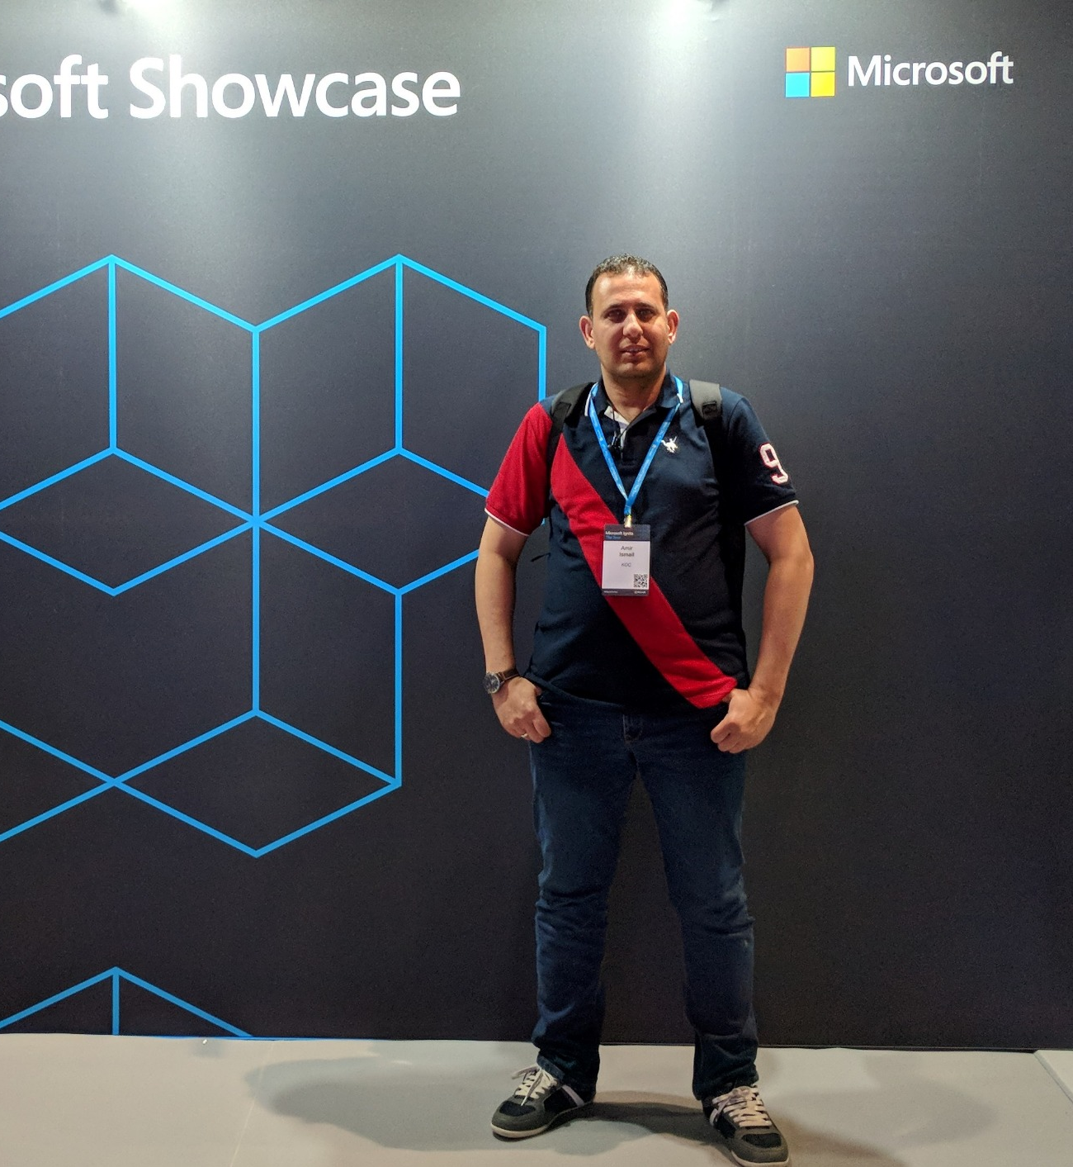
Amir Ismail
Overview
Senior Software Engineer for Kuwait Oil Company.
+15 years of experience in Software Engineering. I participated in multiple projects in different business domains range from E-learning, Banking, Oil, E-booing and Hotels management.
Certifications
PSM I Certified.
ITIL® Certified.
PRINCE2® Certified.
Contact Details
https://www.linkedin.com/in/amirismailyousef/

Slide 6
About Us
".NET Kuwait" is a community group to gather developers, technology enthusiasts from around Kuwait who are interested in programming, .NET, .NET Core, Blazor, open source, new technologies, etc. to share experience, technology passion, learn from others and have fun.
Our main focus will be on .Net and Microsoft Technology but that doesn't mean we will not be discussing other Open Source technologies. Also, we will be discussing Cloud Computing and DevOps practices.

Slide 7
About Us – Cont.
When we Started
June 2019
Why we Started
Build a community with people who want to share their passion for technology

Slide 8

Who can join?
All levels of developers from all different backgrounds are welcome to join and attend our meetups.
Photo by Katie Moum on Unsplash

Slide 9
Milestones so far…
June
July
Aug
Started
Contacted MS MENA
Sep
Received MS MENA support
Hosting .NET Conf 19 local event
Became a part of
.NET foundation
Drafted this year’s plan
Registered for .NET Conf 19 local event

Slide 10
Our Draft Plan for this Year
.NET Today, and Tomorrow (including .NET 5)
Azure DevOps
Testing in VS (CodedUI)
Modernizing Existing .NET Applications
Migrate ASP.NET Web Forms Sites to .NET Core using DotVVM
Create Intelligent Bots with the Azure Bot Service
Create serverless logic with Azure Functions
Classify images with the Microsoft Custom Vision Service
AKS & ACI
Cosmos DB
Introduction into Microsoft Flow
Scrum & Agile Using Azure DevOps
Build your Web App with Aspnetcore & deploy it into Azure

Slide 11

Want to contribute?
Interested in a topic?
Willing to share knowledge?
Contact Us

Slide 12



Contact Us
@dotnetkw
@dotnetkw
.Net Kuwait

Slide 13
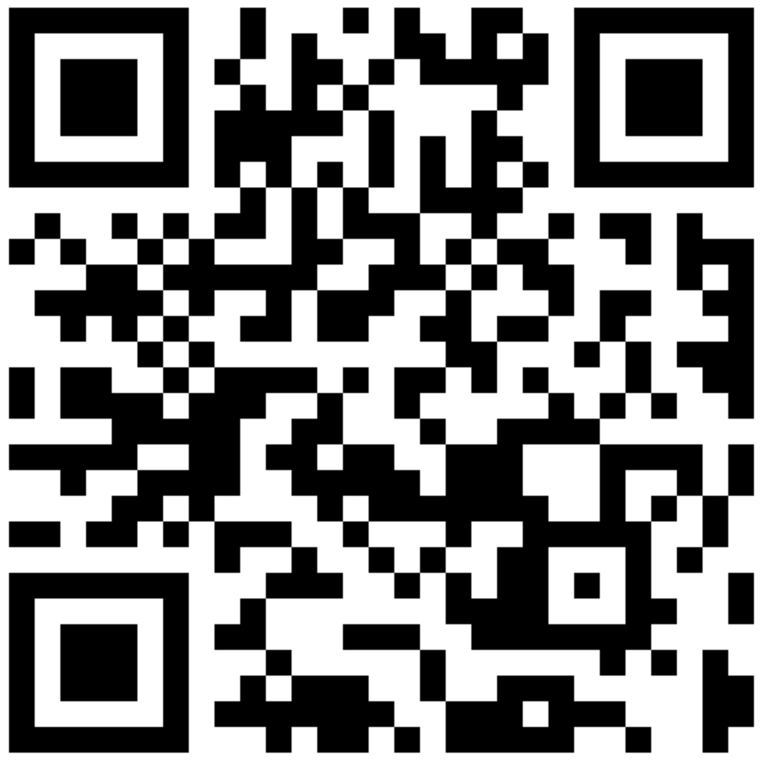
SCAN THE CODE & START YOUR JOURNEY ON .NET today!
https://aka.ms/AA62x0i

Slide 14
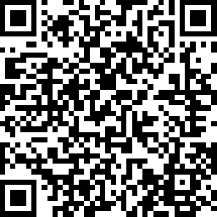
SCAN THE CODE & SEND US YOUR FEEDBACK!
https://www.surveymonkey.com/r/GK96HDK

Slide 15
Thank You

